Slide 1
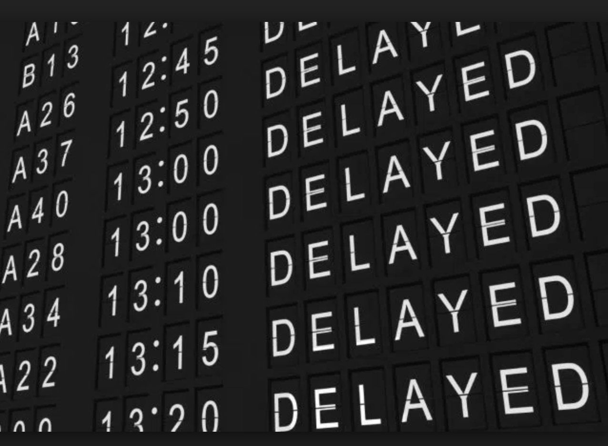
Predicting Flight Delays
FL
Team Front-Left
Peter Resnick, John Ekblad, Todd FitzGerald, Dennis Boston, Scott Kaufman

Slide 2
Project Scope and Data
FL
Can we accurately predict the length of future flight delays based on historical weather conditions.
Explored numerous data sources
Flight Stats, Weather Underground, National Transportation Board
Data collected from a combination of CSV and API’s
Utilized all flight data for US carriers for September, 2017
458,727 flights across 288 US destinations, 784 weather observations
Data clean up
Relatively easy data cleanup, biggest issue – API call limits and response time from customer service (Flight Stats)
CSV file clean up replace NaN with zero
Date timestamp format munging to tie between datasets – Flight statistics and Weather Underground API

Slide 3
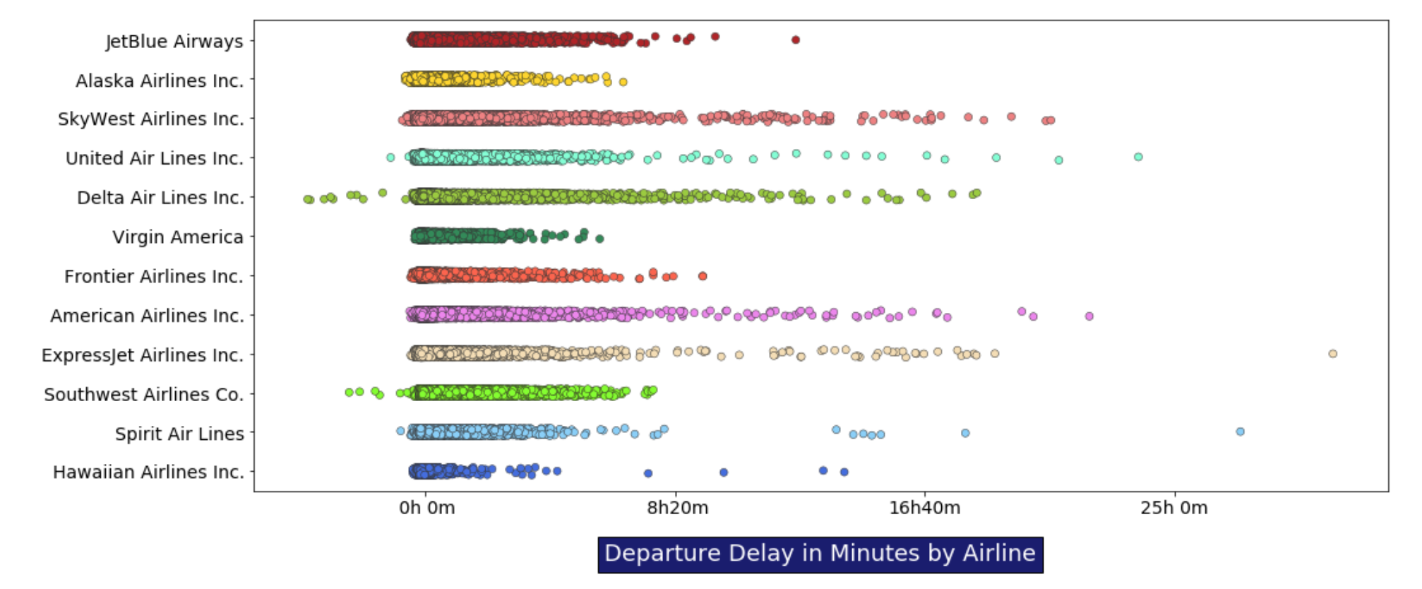
Data exploration
FL

Slide 4
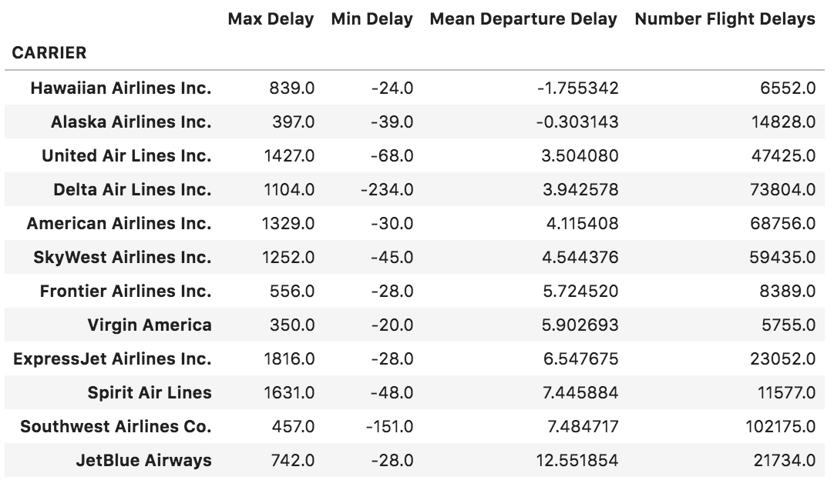
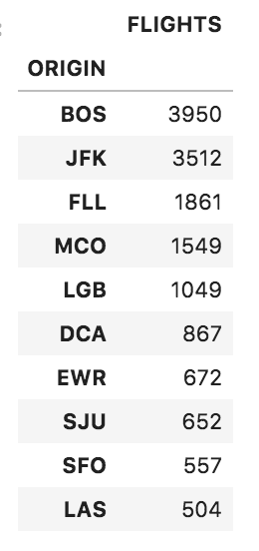
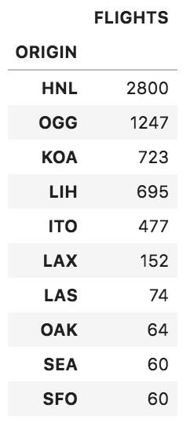
Data exploration
FL
JetBlue Hawaiian

Slide 5
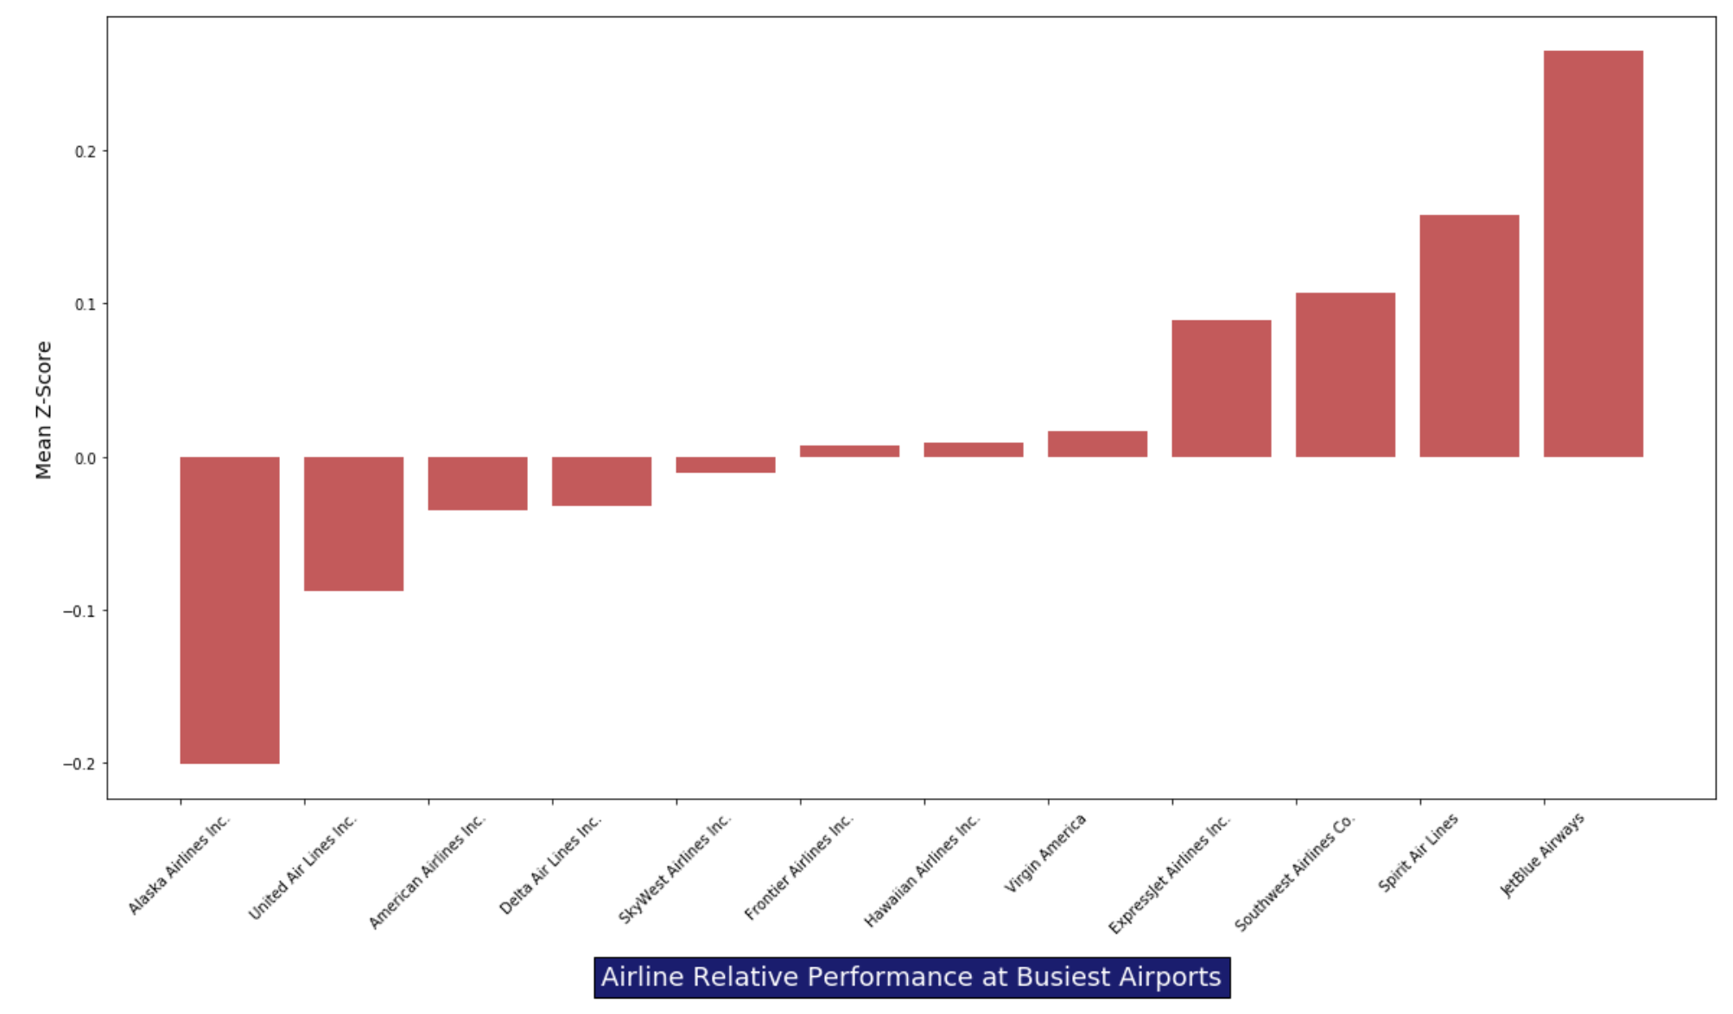
Data exploration
FL

Slide 6
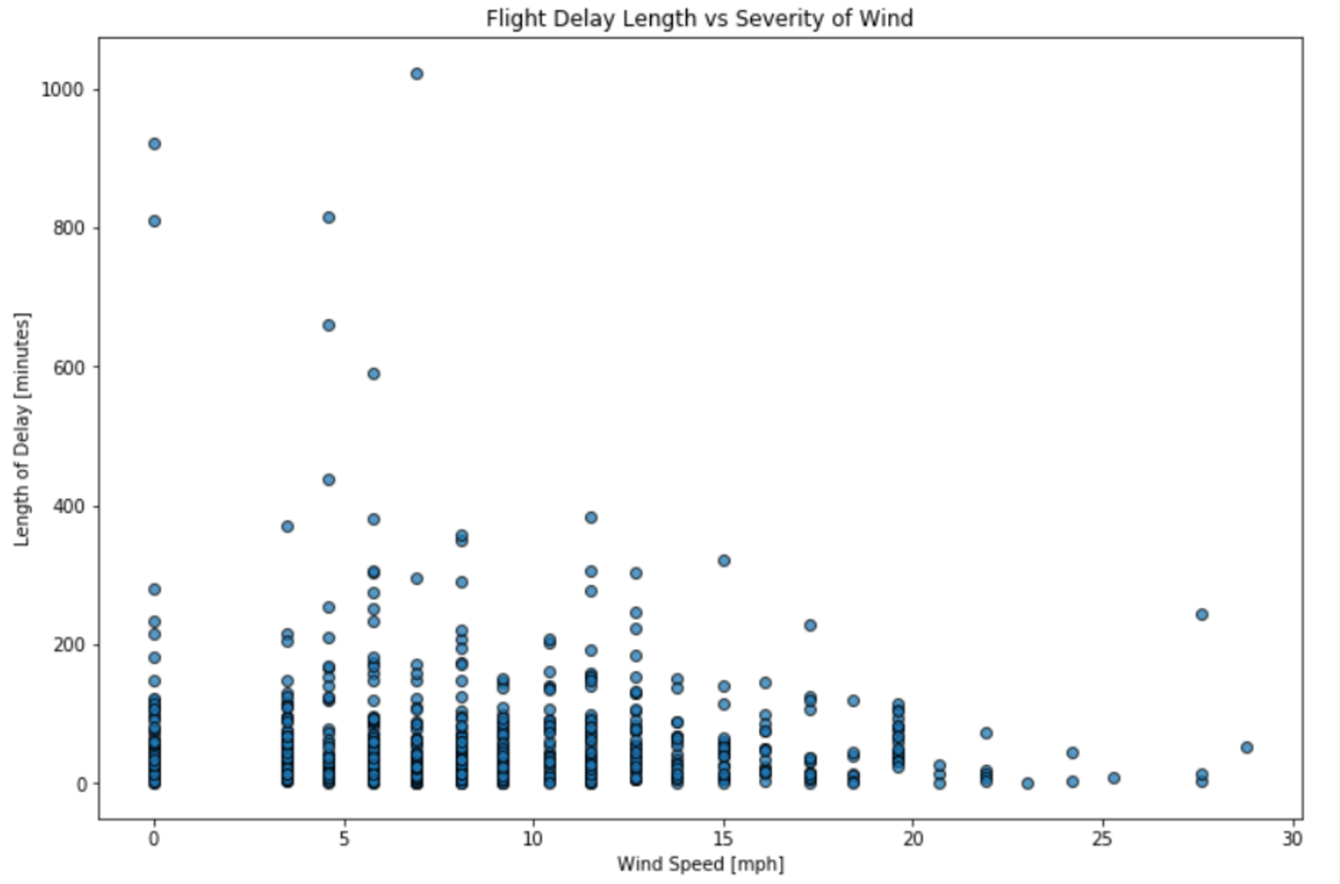
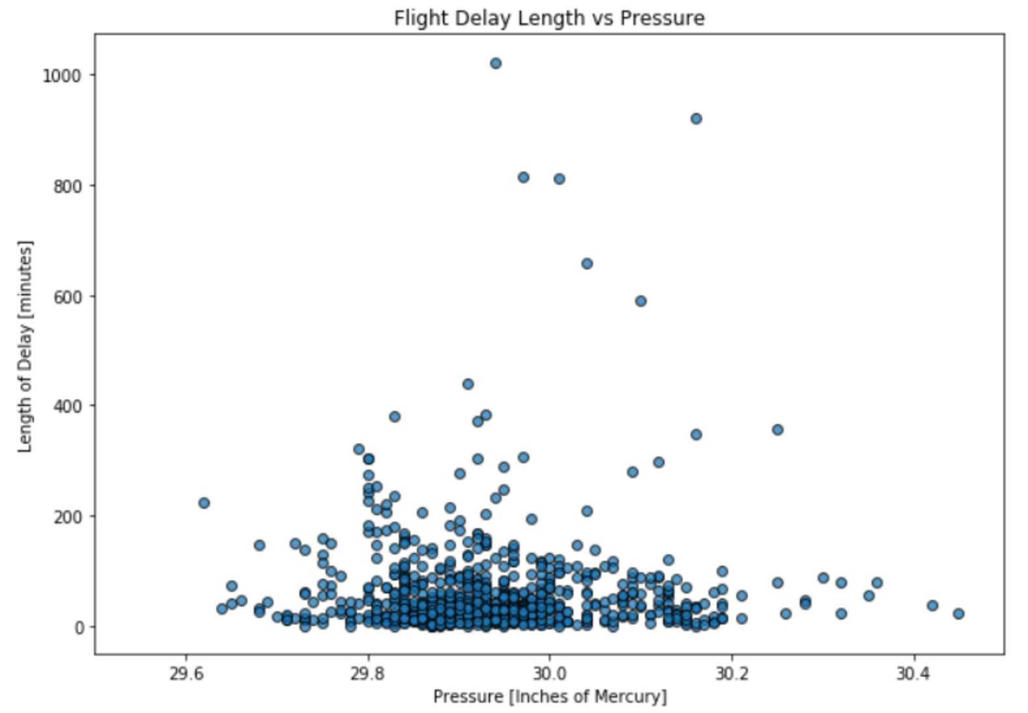
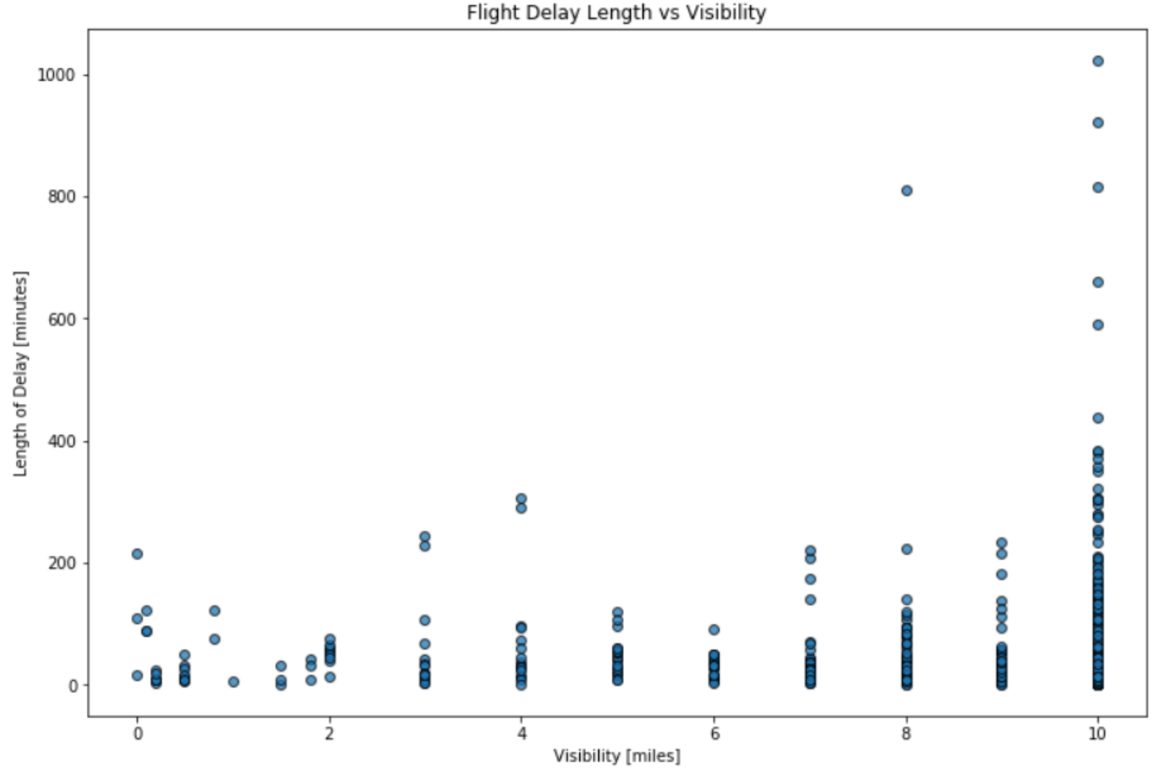
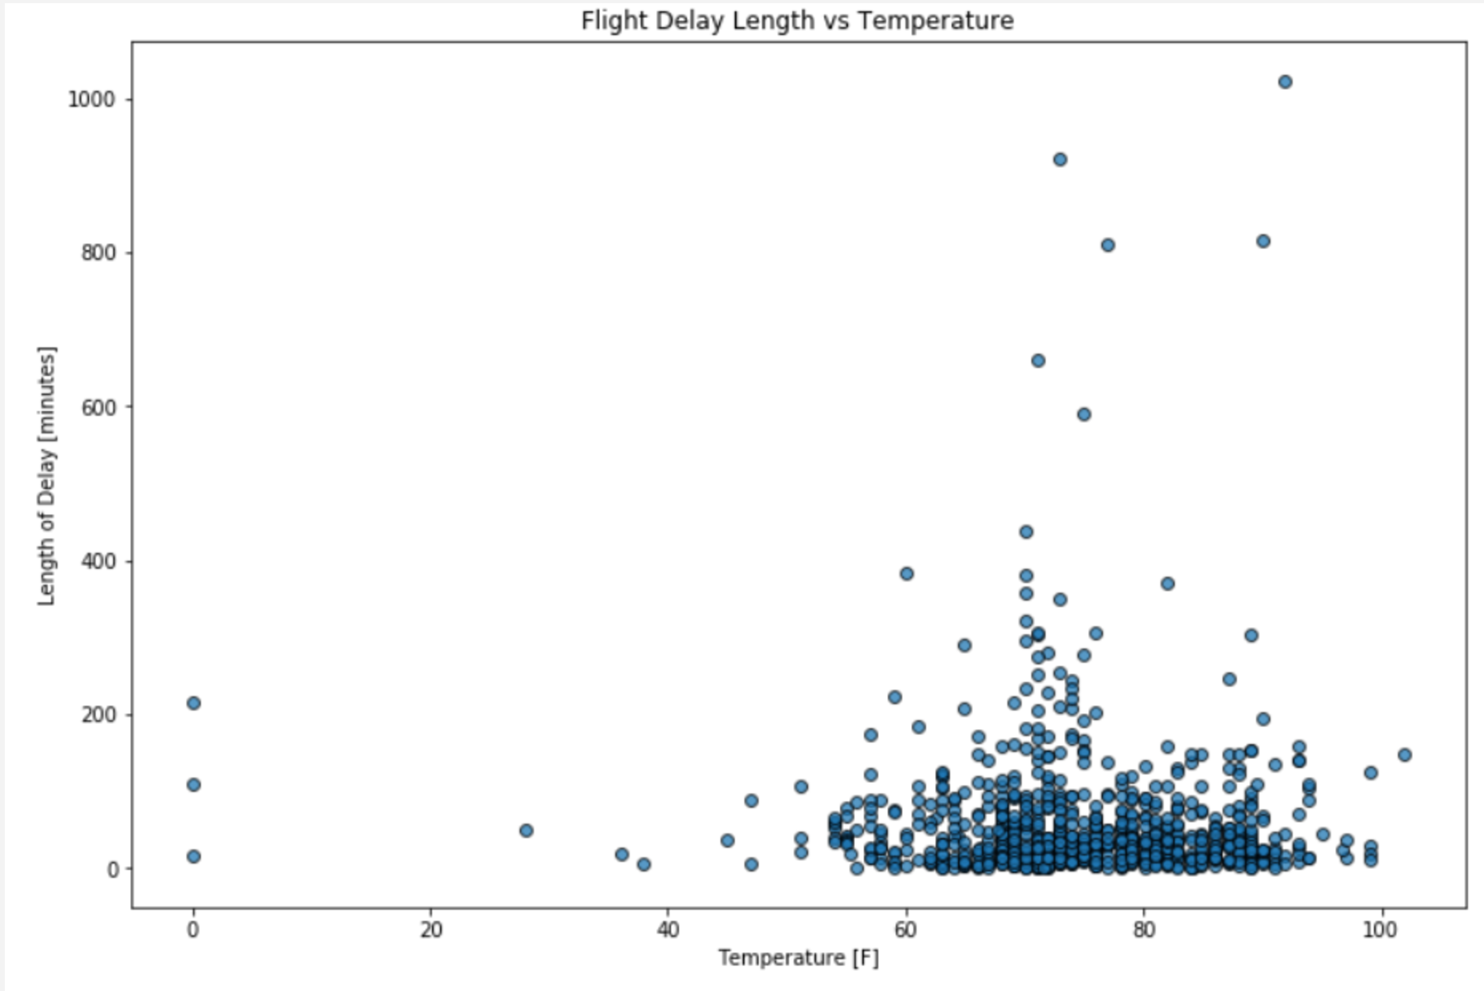
Data analysis
FL

Slide 7
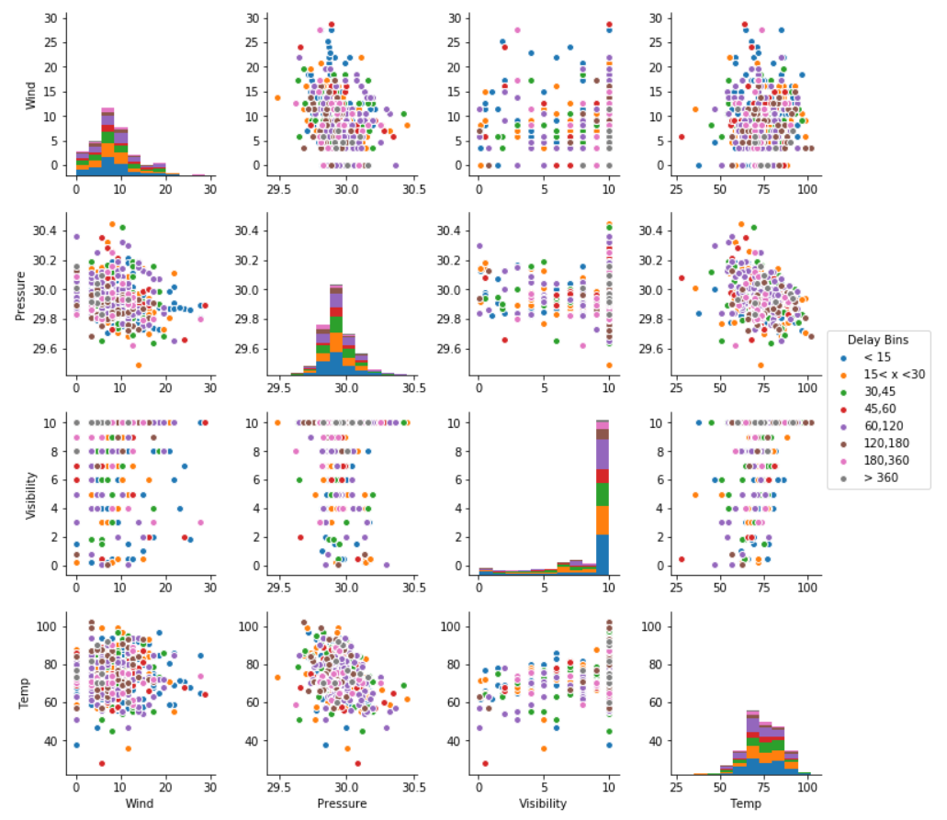
FL

Slide 8
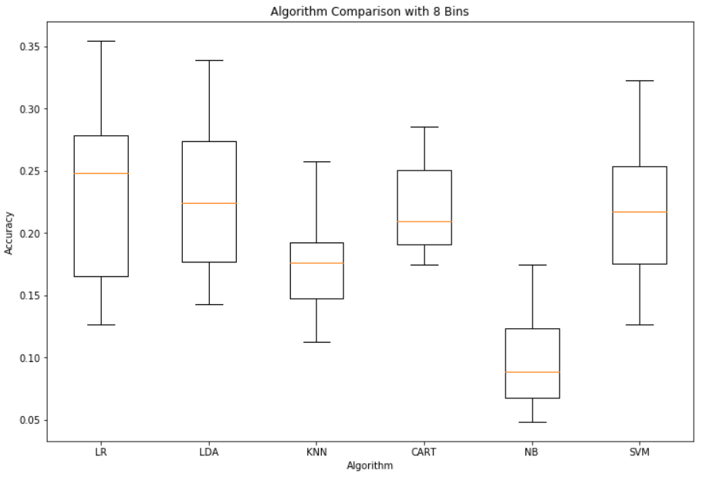
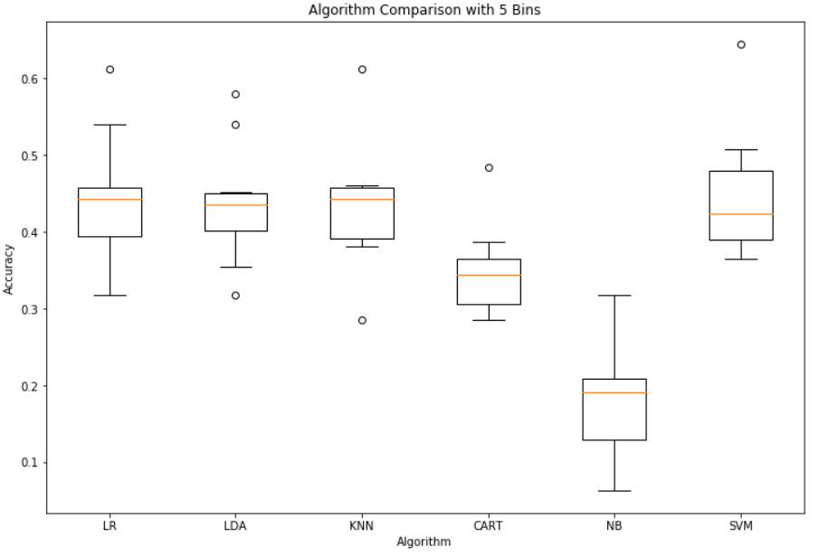
Conclusions
FL
Based on our models and analysis we cannot accurately predict the length of future flight delays based on historical weather conditions.

Slide 9
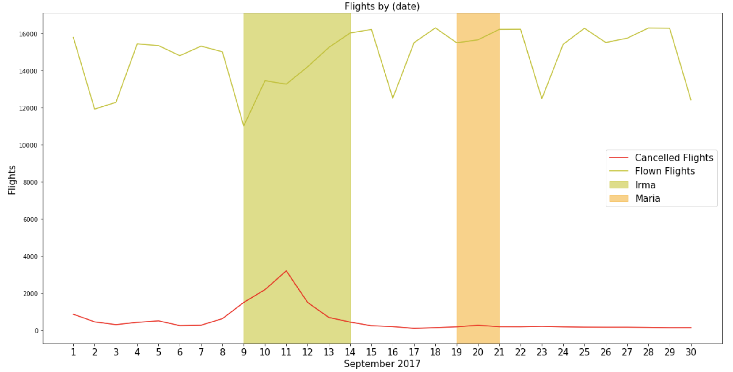
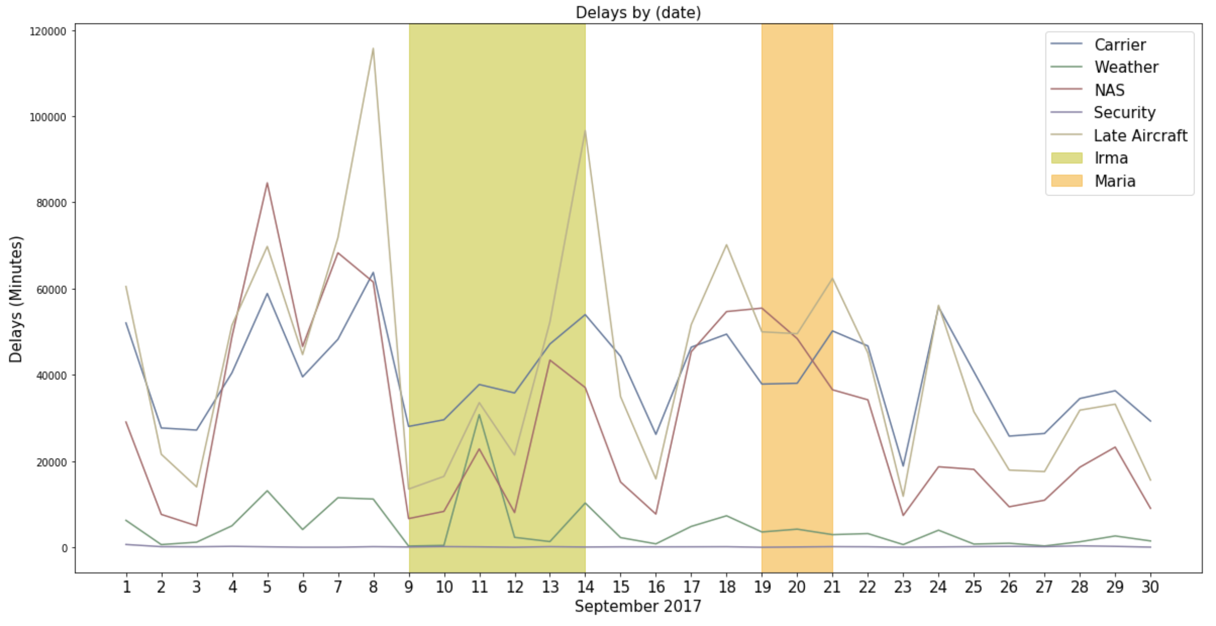
Appendix – Delay observations
FL

Slide 10
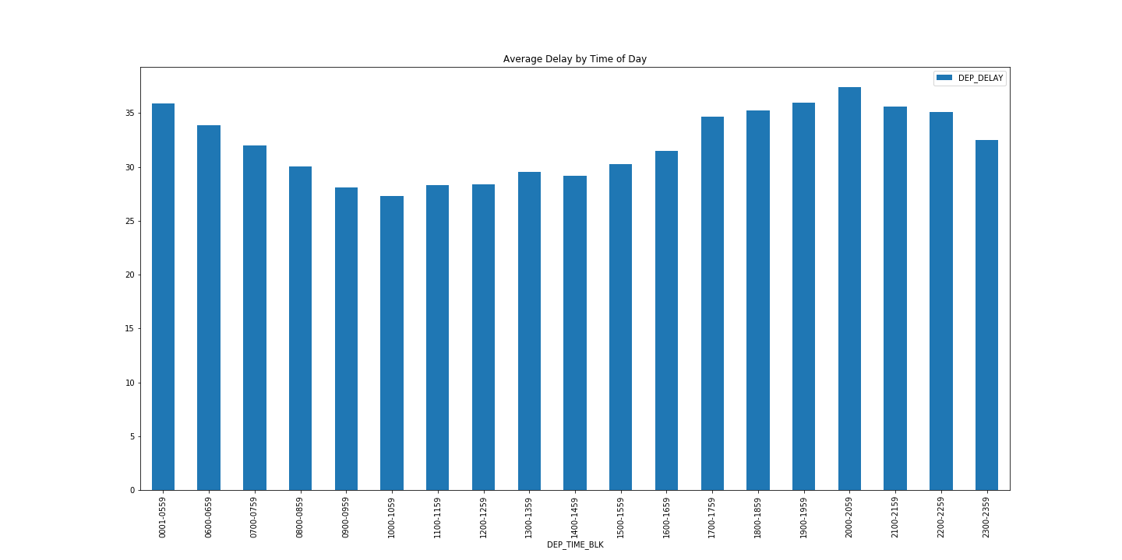
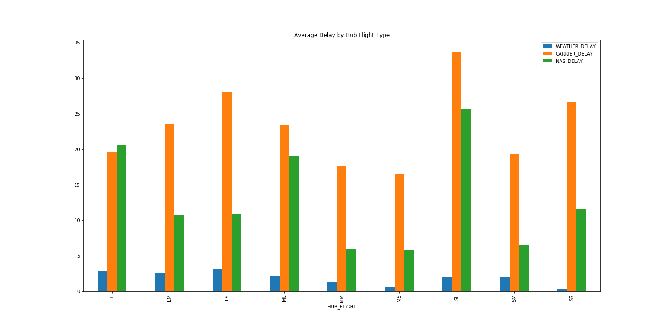
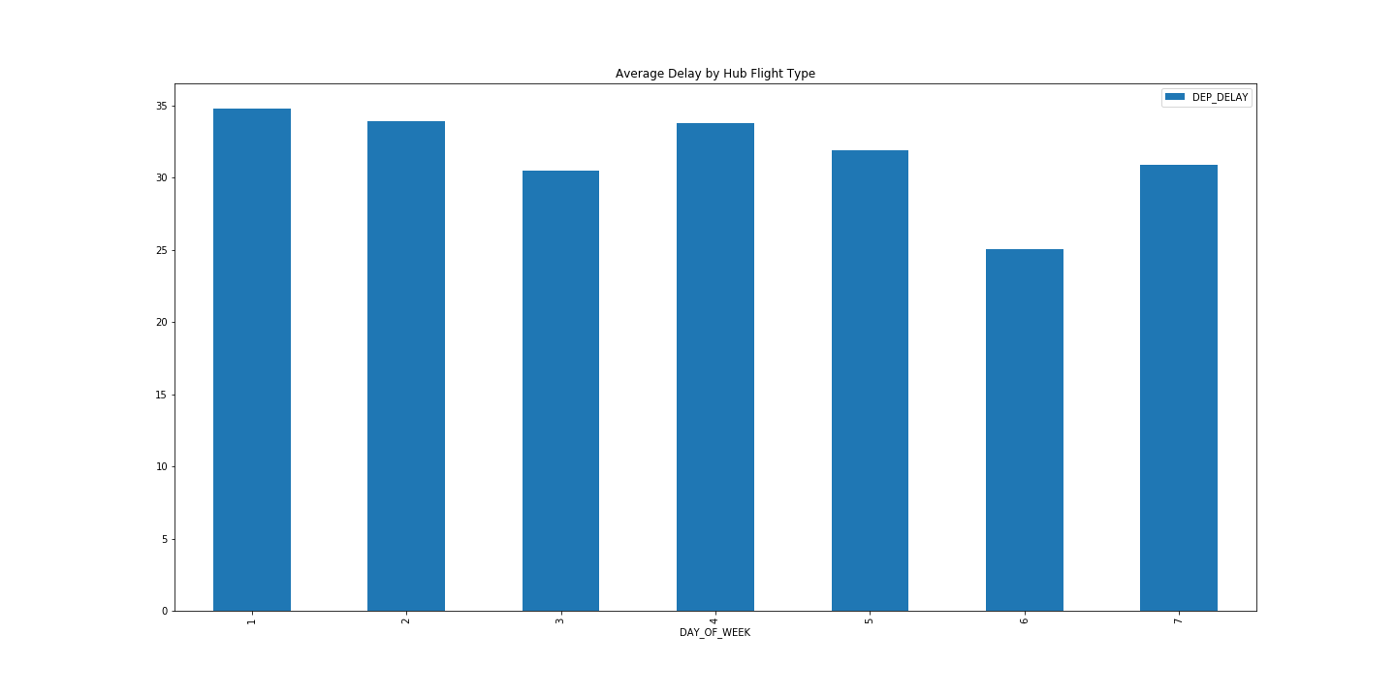
Appendix – Delay observations
FL

Slide 11
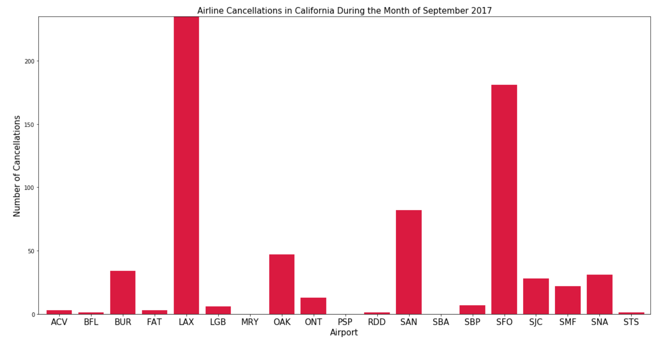
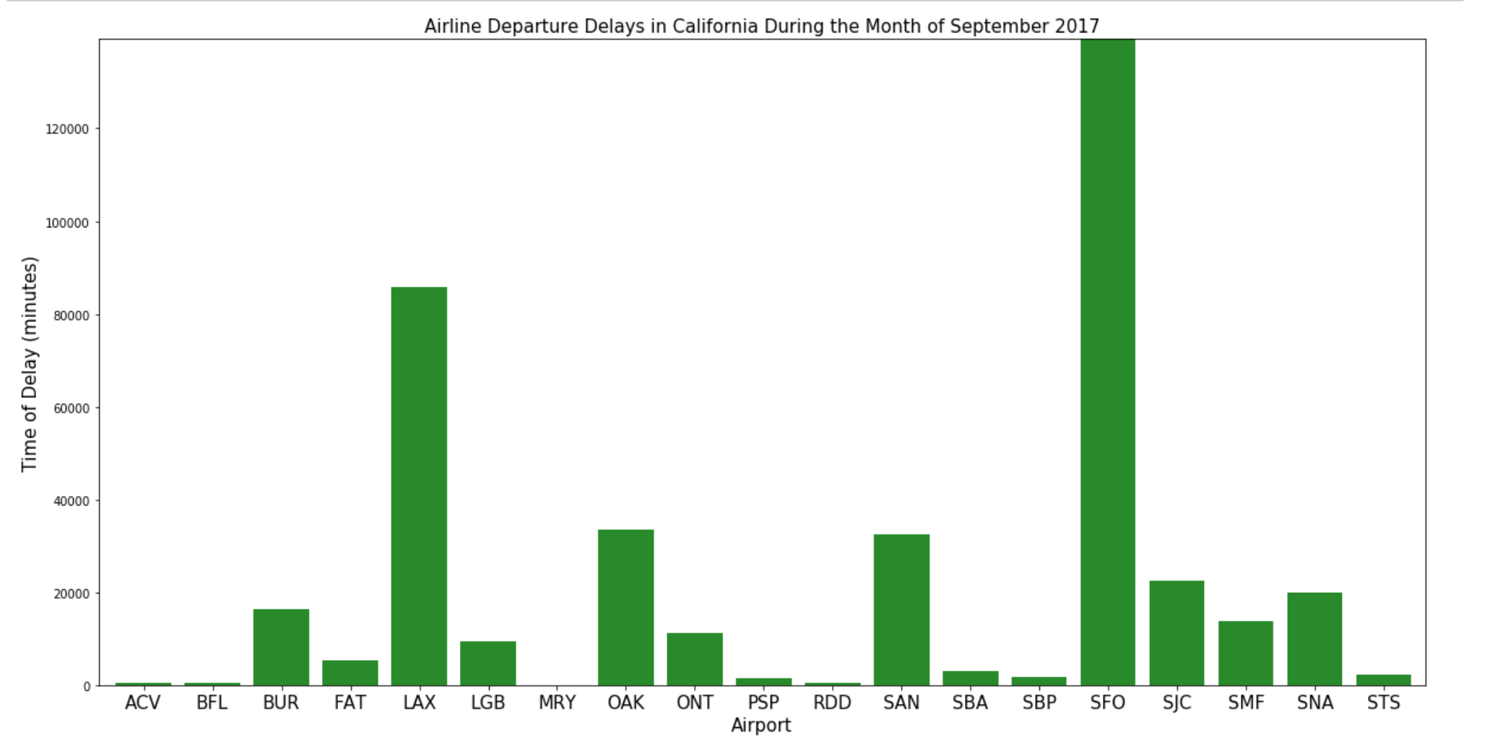
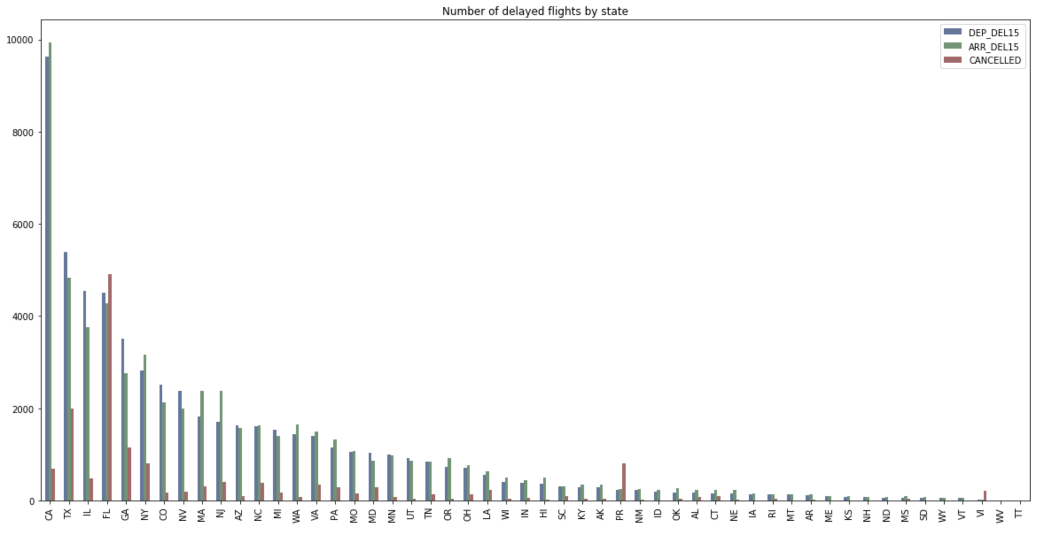
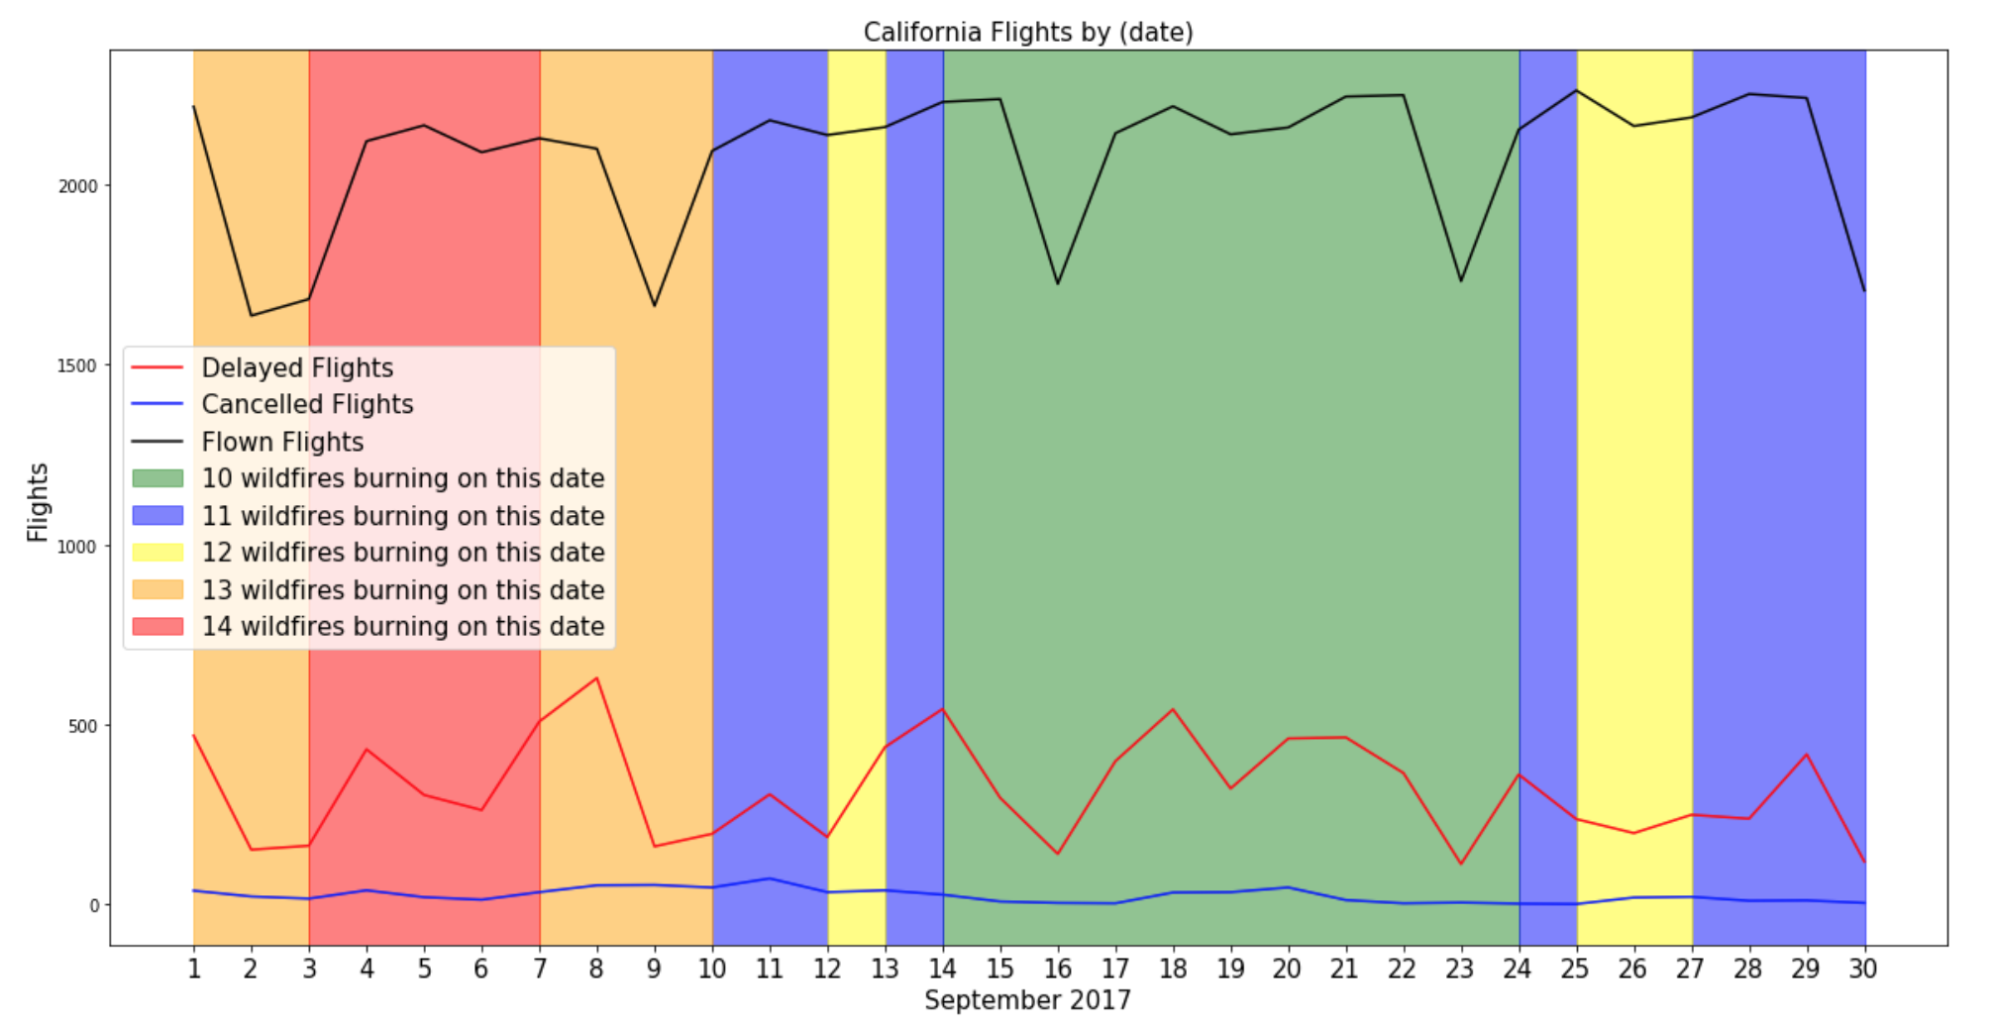
Appendix – California Delay
FL

Slide 12
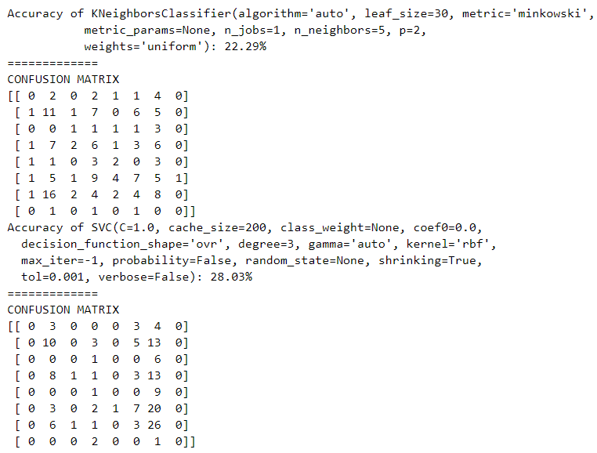
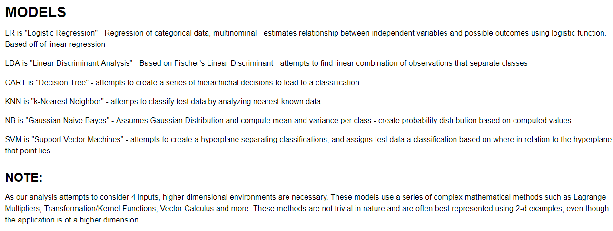
Appendix
FL

